Slide 1
Big 4:
Tan Yiqin
Cui Simeng
Li Xiaotong
Chen Qiman
Fast food fights

Slide 2

C O N T E N T S
01
Rising Chinese-style fast food
-- why we choose the topic
02
Ratings may tell
--our access to the story
Highlights of our superior coding
03
Data analysis
--Things in common
--Café De Coral jumps out
--Hints from Café De Coral
04

Slide 3
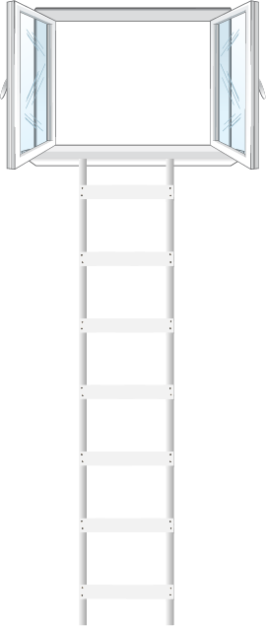
Quick review of fast food market in China
01
Average annual growth rate of 18%;
The fast food segment accounted for 20.8% of total catering industry revenue in 2016;
Forecasts an RMB 1 trillion sales revenue in fast food industry in 2021.
02
The proportion of fast food in catering industry :
35% in U.S
30% in Europe
20% in Japan
5% in China’s first-tier cities
03
Western and Chinese-style fast food restaurant proportion:
10% vs 90%
Fluctuation of market share of McDonal’s and KFC:
57% →37.7%

Slide 4
What do the fast food giants
MISS ?

Slide 5
Ratings may tell
What we scrape
Tastes
Environments
Services
Per capita consumption price
Comment-volumes
Levels of the customers
Who we choose
McDonald’s
KFC
Kungfu Restaurant
Wallace
Café De Coral

Slide 6
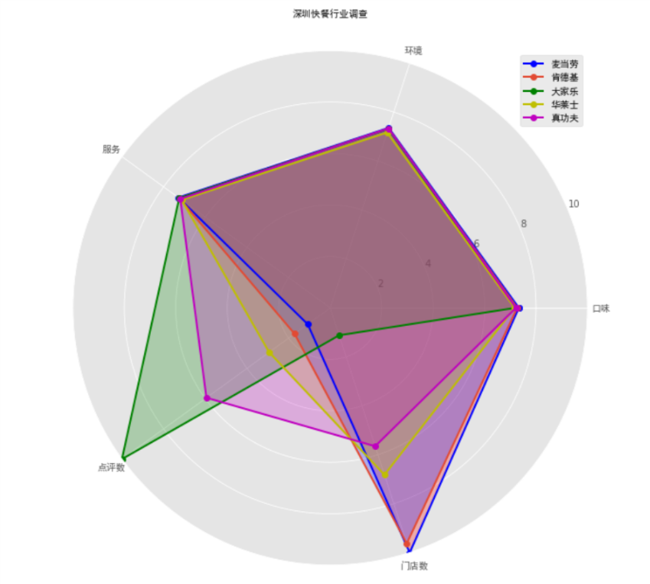
Data Analyse
Things are in common
Homogeneous Competition
ADD YOUR TEXT
Amet adipiscing elit, sed diam nonummy nibh euismod tincidunt ut laoreet dolore magna
Competition based on the homogeneous product, which (from the consumer's viewpoint) have little or no differentiation in terms of features, benefits, or quality.
ADD YOUR TEXT
Amet adipiscing elit, sed diam nonummy nibh euismod tincidunt ut laoreet dolore magna

Slide 7
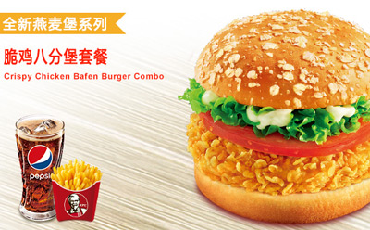
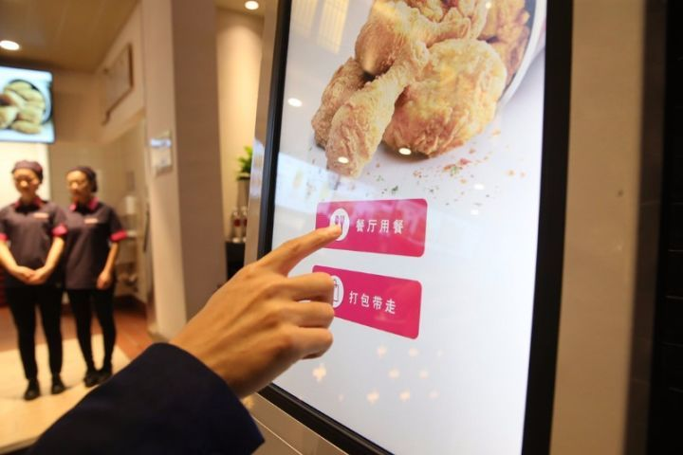
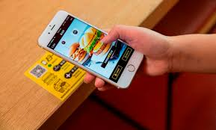
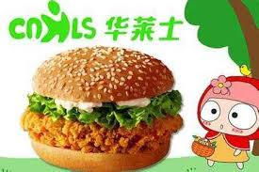
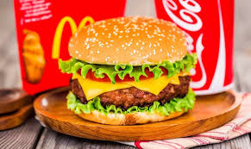
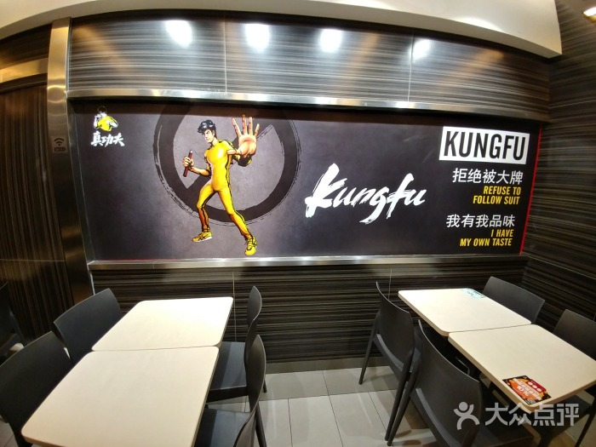
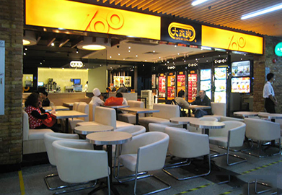
Data Analyse
Things are in common
Food Flavor
Standardized food products
Service
Combine staff service with mobile ordering, have online delivery food service, and establish central food process and logistic center
Restaurant Environment
Well-decorated to suit for fast and comfortable dining styles

Slide 8
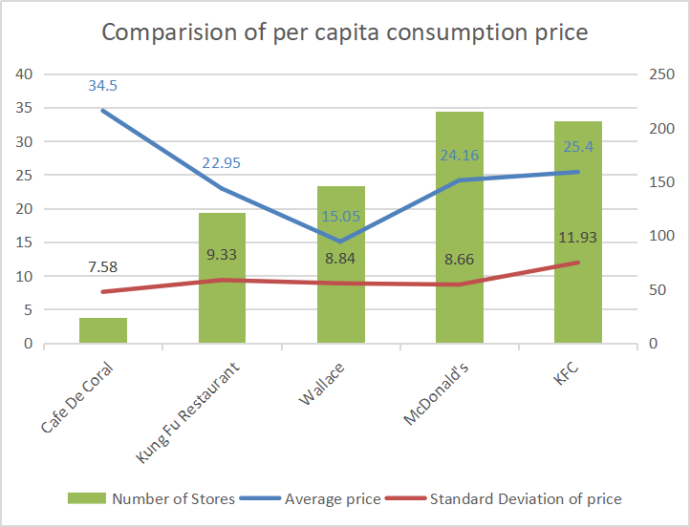
Data Analyse
Café De Coral Jumps Out
KEY
WORDS
Price is the highest
consumers are still willing to afford more expensive food in Cafe De Coral
KEY
WORDS
KEY
WORDS
SD level is flat
KEY
WORDS
KEY
WORDS
KEY
WORDS
From the consumer insight, consumer’s willingness to afford the prices in different restaurants of five brands is similar
Differentiated strategies
Quality dishes and creating new dish choices

Slide 9
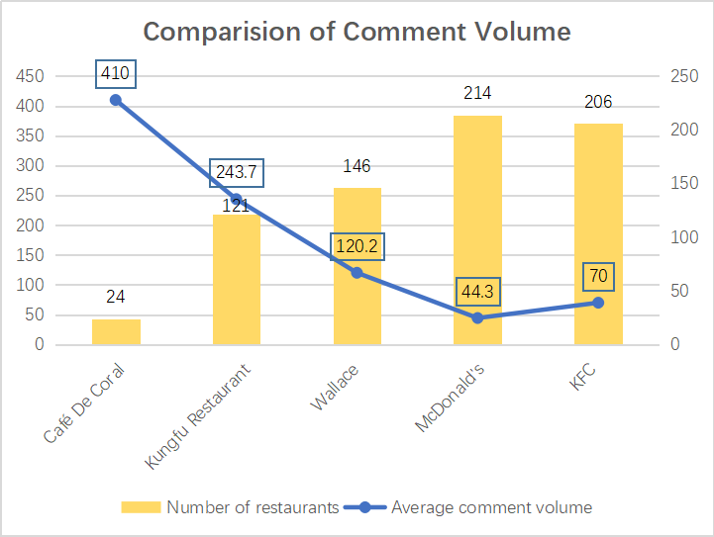
Data Analyse
Café De Coral Jumps Out
KEY
WORDS
Huge volume of comments
It is uncommon as target consumers of fast food are always in pursue of convenience and shorter meal time.
KEY
WORDS
KEY
WORDS
KEY
WORDS
KEY
WORDS
KEY
WORDS

Slide 10
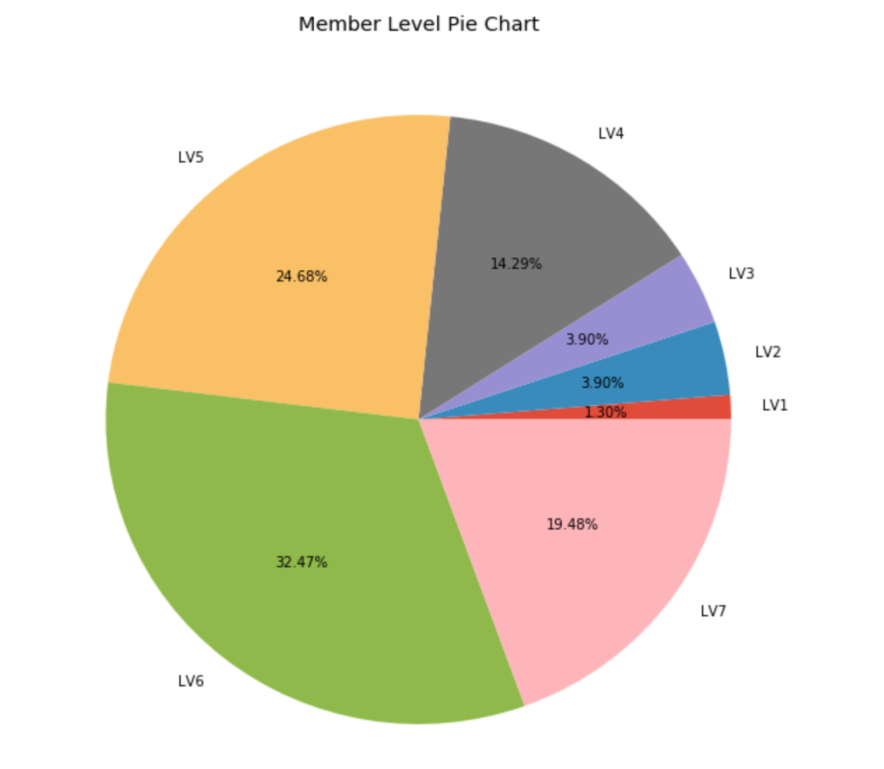
Data Analyse
Café De Coral
KEY
WORDS
KEY
WORDS
Authentic customers
KEY
WORDS
KEY
WORDS
KEY
WORDS
KEY
WORDS
Three quarters of the Café De Coral customers are above level three

Slide 11
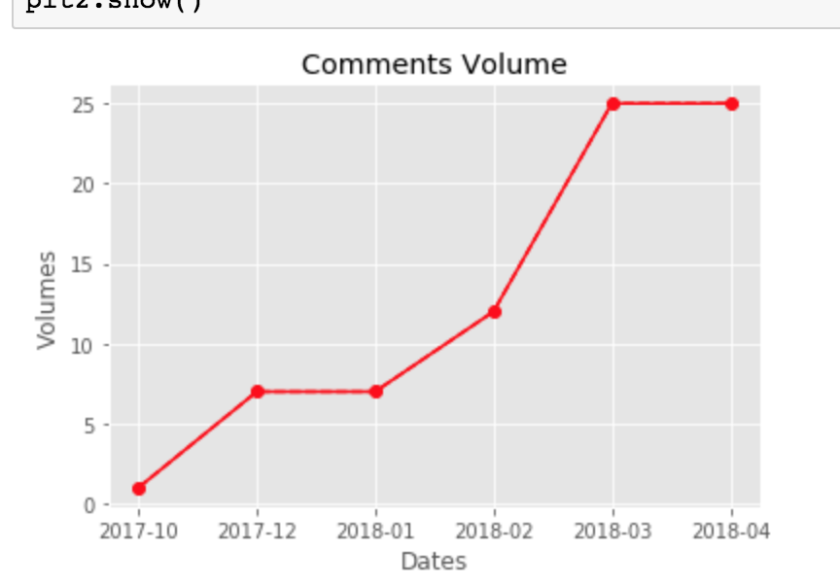
Data Analyse
Café De Coral
An outburst of comments in 2018.

Slide 12
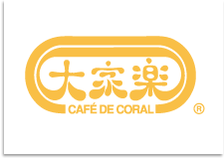
Possible reasons behind
--Answers from annual report
01
Revamp of menu
02
New customer relationship management program
03
New business model

Slide 13
Data Analyze
Café De Coral
KEY
WORDS
High frequency words
KEY
WORDS
KEY
WORDS
“Pork Steak”
“Milk tea”
“Afternoon tea”
……
KEY
WORDS
KEY
WORDS
KEY
WORDS

Slide 14

Localization
Faster response to the change of
customer behavior
01
02
Differentiation
-- Courses
-- Brand building
Hints from Café De Coral

Slide 15

Coding problems we met
01
Data Reorganization
02
Anti-parser
IP Blocking
03
Data normalization

Slide 16

THANK YOU

